Slide 1
Meal Harmony: Using Machine Learning to Simplify Food Choices

Slide 2
Problem Statement

Slide 3
Project aims to solve this problem by creating a system that suggests personalized meal options using mathematical analysis by stats.

Slide 4
Literature Review

Slide 5
Introduction to the Project
Daily household problems
Repetitive and Unhealthy instant options to eat
Health Issues
Ingredients Unavailability
Weather Conditions

Slide 6
Introduction to the Project
Daily household problems
Repetitive and Unhealthy instant options to eat
Health Issues
Ingredients Unavailability
Weather Conditions

Slide 7
Introduction to the Project
Daily household problems
Repetitive and Unhealthy instant options to eat
Health Issues
Ingredients Unavailability
Weather Conditions

Slide 8
Introduction to the Project
Daily household problems
Repetitive and Unhealthy instant options to eat
Health Issues
Ingredients Unavailability
Weather Conditions

Slide 9
Time aware food recommendation system
Rostami, mourad, farrahi 2022
Better dietary choices
Integration into various lifestyles, new users, food items, communities
Methodology- graph clustering for similarities using similarity matrix- predicts new using historic data and similarities among users.
recommends top-rated options to users, combining user-based and content-based predictions.
Time Dynamics to enhance quality

Slide 10
Recipe recommendation system using machine learning models
suyash maheshwari , mansas chourey 2019
word2vec annd vector space models to identify ingredients
Big data Analytics- data collected using web scraping texhnques
Non-negative Matrix Factorization (NMF) as a machine learning model to suggest different pairs of ingredients.(feature and coefficient matrices)

Slide 11
Food Recommender System considering Nutritional Infromation and User preferences
Toledo, Alzahrani, Martinez 2019
personal choices + nutritional requirements
Multi criteria decision analysis MCDA - to select among multiple conflicting criterias
Layers: Informationn Gathering, user profile dataset, intelligent system, end user interface

Slide 12
Project Overview

Slide 13
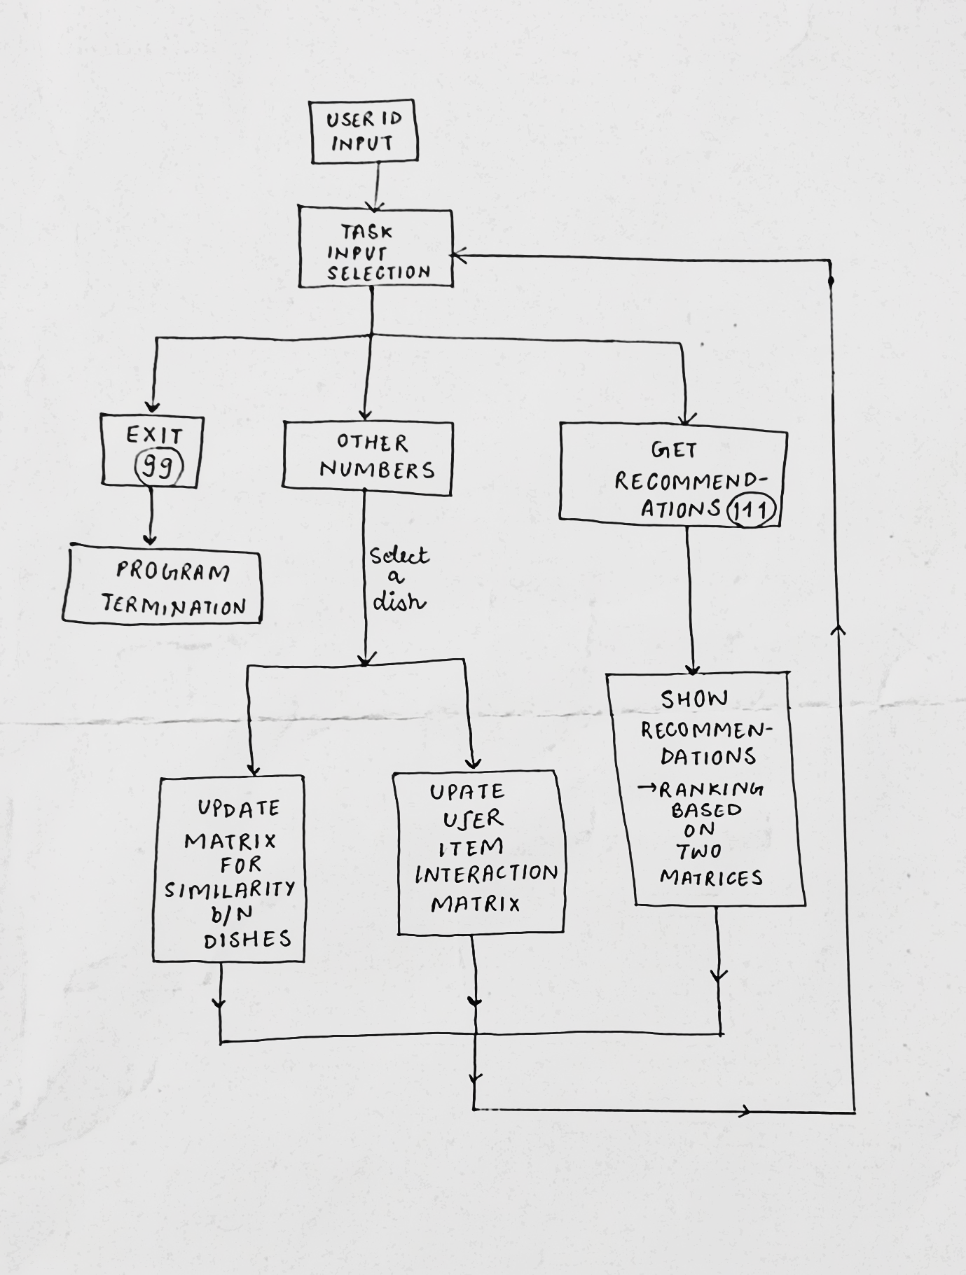

Slide 14
Explanation and Demonstration

Slide 15
Future Plan

Slide 16
Conclusion

